Slide 2
JDBC

Slide 3
Introduction
JDBC is a Java Database Connectivity API that lets user access virtually any tabular data source from a Java application.
Additionally provides connectivity to a wide range of SQL databases, and allows user to access other tabular data sources such as spreadsheets or flat files.
JDBC defines a low-level API designed to support basic SQL functionality independently of any specific SQL implementation. This means the focus is on executing raw SQL statements and retrieving their results.
JDBC is based on the X/Open SQL Call Level Interface, an international standard for programming access to SQL databases.
The JDBC 2.0 API includes two packages: java.sql, known as the JDBC 2.0 core API; and javax.sql, known as the JDBC Standard Extension. Together, they contain the necessary classes to develop database applications using Java.

Slide 4
contd..
As a core of the Java 2 Platform, the JDBC is available on any platform running Java.
The JDBC 3.0 Specification, released in October 2001, introduces several features, including extensions to the support of various data types, additional MetaData capabilities, and enhancements to a number of interfaces.
JDBC – a module of jdk, provides for backend database connectivity.
Java is linked with backend database through JDBC driver.
JDBC Driver – A software component that enables a Java application to interact with a database.
JDBC driver works in two steps
provides Connection with the database
implements the protocol for transferring the query and result between the client and the database.

Slide 5
Two-Tier Model
Supports both two-tier model for database access. JDBC can either be used directly from an application or as part of a middle-tier server application.
Here in a Java application interacts directly with the database.
Functionality is divided into these two layers:
Application layer, including the JDBC driver, business logic,
and user interface
Database layer, including the RDBMS
JDBC operates through drivers. There are four types of drivers.
The interface to the database is handled by a JDBC driver appropriate to the particular database management system being accessed.
The JDBC driver passes SQL statements to the database and returns the results of those statements to the application.

Slide 6
contd..
Type 1
The Type 1 driver is known as the
JDBC–ODBC Bridge driver.
The driver converts JDBC function
calls into ODBC function calls.
The driver is platform dependent.
It needs to be installed on the
client machine.
Not suitable for applets.
End -User
JDBC Driver Manager
JDBC – ODBC Bridge
ODBC Driver
Data Base

Slide 7
contd..
Type 2
The Type 2 driver is known as the
Native–API driver.
Uses the client side libraries of
the database.
The driver converts JDBC method
calls into native calls of database
API.
The driver is platform dependent.
It needs to be installed on the client
machine.
Not suitable for applets.
End-User
JDBC Driver Manager
Native API Driver
Data Base

Slide 8
contd..
Type 3
The Type 3 driver is known as the Network Protocol driver.
The driver converts JDBC function calls into ODBC function calls.
It makes use of a middle ware that converts JDBC method calls into vendor specific database calls.
Same driver can be used for multiple vendors.
Type 3 is platform independent.
Can be used on inter net as no client side software is needed.
End -User
JDBC Driver Manager
Network Protocol Driver
Middleware (Application Server)
Data Base
Data Base

Slide 9
contd..
Type 4
The Type 4 driver is known as the
Native Protocol driver. It is also
known as direct to database pure
Java driver.
The driver is platform independent.
Does not need associated software to
work.
End -User
JDBC Driver Manager
Native-Protocol Driver
Data Base

Slide 10
contd..
Steps in using JDBC
Load the driver
Define the Connection URL
Establish the Connection.
Create a Statement Object
Execute the query
Close the connection

Slide 11
contd..
Load the driver – the Driver is loaded using the method forName().
Define the Connection URL – the URL is defined as the String object.
Establishing the Connection – the Connection is established using the Connection object.
Creating the Statement – the statement is created using the Statement
Execute the Query
Close the connection – the connection is closed using the close() method.

Slide 12
contd..
The JDBC API defines standard mappings between SQL data types and Java/JDBC data types, including support for SQL99 advanced data types such as BLOBs and CLOBs, ARRAYs, REFs, and STRUCTs.

Slide 13
contd..
Sun defines the following levels of JDBC compliance:
JDBC 1.0 API Compliance, which requires implementation of the following interfaces:
java.sql.Driver
java.sql.DatabaseMetaData
java.sql.ResultSetMetaData
java.sql.Connection
java.sql.Statement
java.sql.CallableStatement
java.sql.PreparedStatement
java.sql.ResultSet
JDBC 2.0 API Compliance, requires –
JDBC 1.0 API compliance
Full implementation of the DatabaseMetaData interface extensions defined in JDBC 2.0
Implementation of additional JDBC 2.0 ResultSet methods

Slide 14
contd..
Connection – provides for a connection (session) with a specific database.
Statement – provides for the object used for executing a static SQL statement and returning the results it produces.
PreparedStatement – A PreparedStatement is a SQL statement that is precompiled and stored in a PreparedStatement object. This object can then be used to execute this statement multiple
times.
CallableStatement – CallableStatement is used to execute SQL stored procedures. CallableStatements are created by the method prepareCall().
ResultSet – provides for a table of data representing a database result set, which is usually generated by executing a statement that queries the database.

Slide 15
contd..
Methods of Connection interface
void close() – releases the Connection object's database and JDBC resources immediately
void commit() – makes all changes made since the previous commit/rollback permanent; releases any database locks currently held by this Connection object.
Statement createStatement() – Creates a Statement object for sending SQL statements to the database.
Statement createStatement (int resultSetType, int resultSetConcurrency) – Creates a Statement object that will generate ResultSet objects with the given type and concurrency.
Statement createStatement(int resultSetType, int resultSetConcurrency, int resultSetHoldability) – Creates a Statement object that will generate ResultSet objects with the given type, concurrency, and holdability.

Slide 16
contd..
Methods of Statement interface
ResultSet executeQuery(String sql) – Executes the given SQL statement, which returns a single ResultSet object.
int executeUpdate(String sql) – Executes the given SQL statement, which may be an INSERT, UPDATE, or DELETE statement or an SQL statement that returns nothing, such as an SQL DDL statement.
ResultSet execute(String sql) – Executes the given SQL statement returning ResultSet object. may return multiple results.

Slide 17
contd..
Methods of PreparedStatement interface
void setInt(int paramidx, int val) – sets integer value to the given parameter index.
void setString(int paramidx, String val) – sets String value to the given parameter index.
void setDouble(int paramidx, double val) – sets double value to the given parameter index.
void setFloat(int paramidx, float val) – sets float value to the given parameter index.
int executeUpdate() – executes the query, used to create, drop, insert, update, delete.
ResultSet executeQuery() – executes the select query, returns an instance of ResultSet.

Slide 18
contd..
Methods of CallableStatement interface
Methods inherited from Statement interface and PreparedStatement interface.

Slide 19
contd..
Methods of ResultSet Interface
Statement getStatement() – Retrieves the Statement object that produced this ResultSet object.
String getString(int colidx) – Retrieves the value of the designated column in the current row of this ResultSet object as a String.
int getInt(int colidx) – Retrieves the value of the designated column in the current row as int value.
float getFloat(int colidx) – Retrieves the value of the
designated column in the current row as float value.
Date getDate(int colidx) – Retrieves the value of the
designated column in the current row as java.sql.Date object.

Slide 20
contd..
java.sql classes
DriverManager – provides for the basic service for managing a set of JDBC drivers.
Methods of DriverManager
static Connection getConnection(String url) – Attempts to establish a connection to the given database URL.
static Connection getConnection(String url, Properties info) – Attempts to establish a connection to the given database URL.
static Connection getConnection(String url, String user, String password) – establishes a connection to the given database URL.
static Driver getDriver(String url) – locates a driver that understands the given URL.
static Enumeration getDrivers() – Retrieves an Enumeration with all of the currently loaded JDBC drivers to which the current caller has access.

Slide 21
Thank You

Slide 22

SERVLETS

Slide 23
Contents
Introduction to Servlets
Servlet API
Request and Response
Servlet Config
Servlet Context
Navigation
Servlet Filters
Session Management
Cookies
Listeners

Slide 24
Flow Diagram
End User / Client
Server- 1
(TomCat)
Server- 2
(DataBase)

Slide 25
Servlets
Introduction –
Servlets are server-side programs which accept input from the incoming client request, process the request and generate a suitable response.
The response can be –
sending to the client back the data
redirecting the incoming page to another servlet
forwarding it to another server, etc.
updating the backend table and responding to client about it
do content generation or business logic process (possibly by accessing database, invoking EJBs, etc)
Servlets are deployed on the Server and contained inside the servlet container.

Slide 26
Why Servlets
Servlets features
Efficient
Scalable
Portable
Powerful
Secure
Inexpensive
The Java Virtual Machine ensures that the code does not perform illegal operations.
Also, rather than crashing, programs will throw exceptions which can be caught by the Web Server.

Slide 27
Request - Response model
Request
HTTP
Request
Servlet
HTTP
Response
Web Server
Response
HTTP
Servlet Container
Web Browser(s)

Slide 28
HTTP
The Hypertext Transfer Protocol (HTTP) is an application-level protocol for distributed, collaborative, hypermedia information systems.
The protocol was developed by ……….. who also, later also wrote RESTful Web services.
HTTP –
HTTP is a stateless protocol.
HTTP does not maintain a persistent connection.
Each request made by a Web browser, for HTML page, or an image or other Web object is made via a new connection.
Without an ongoing session, however, it is difficult for developers to maintain state across HTTP requests.

Slide 29
contd..
Communication in HTTP is around a concept called Request – Response cycle.
To maintain a valid request, the client needs to include four things
URL – a way for the client to tell the server which things it wants.
Method – specifies the action the client intends the server to take in. The four most common methods are
GET – asks server to retrieve a resource
POST – asks the server to create a new resource
PUT – asks the server to edit/update the existing resource
DELETE – asks the server to delete the resource.
List of Headers - provide meta info about a request.
Body – contains the data the client wants to send the server.

Slide 30
contd..
Request
Response
URL
Status Code
Method
Headers
Headers
Body
Body

Slide 31
contd..
Data Formats – The most common formats found in APIs are
JSON
XML
JSON – a very simple format that has two pieces key and value
XML provides a few building blocks. The main block is called a node. The name of the node tells user the attribute of the order and data inside is the actual details.

Slide 32
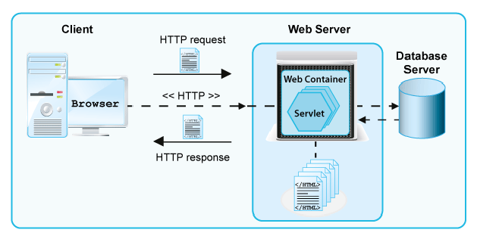
Web Container
The Web container is a component of the Web–server
Services of WC to the web applications include –
Communication Support
Lifecycle Management
Multithreading Support
Declarative Security
JSP Support

Slide 33
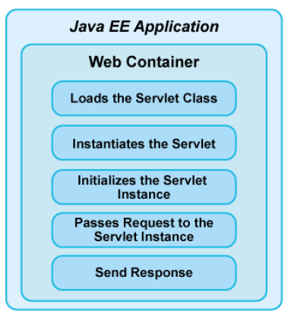
contd..
The following figure shows the tasks performed by the Web container when the client request is received for the first time.

Slide 34
Request and Response
Request and Response
Methods in the HttpServlet class that handle client requests take in two arguments:
HttpServletRequest object, which encapsulates the data from the client.
HttpServletResponse object, which encapsulates the response to the client
The HttpServlet handles client requests through its service() method.
The service() method supports standard HTTP client requests by dispatching each request to a method designed to handle that request.

Slide 35
contd..
Request – information sent from client to a server
who made the request
user-entered data
HTTP headers
Response – information sent to client from a server
Text(html, plain) or binary (image) data
HTTP headers, cookies, etc

Slide 36
contd..
Http Request Header
The information, in the form of a text record, that a user’s browser sends to a Web server contains the details of what the browser wants and will accept back from the server.
The request header also contains the type, version and capabilities of the browser that is making the request so that server returns compatible data.
The servlet container creates an HttpServletRequest object, HttpServletResponse object and passes it as an argument to the servlet's service methods

Slide 37
contd..
Http Response Header
Its the information, that a Web server sends back to a client’s browser in response to receiving an HTTP request. Its in the form of a text record,
The response header contains the date, size and type of file that the server is sending back to the client and the data about the server itself.
The header is attached to the files being sent back to the client.

Slide 38
Servlet API
The entire Servlet API consists of two packages namely –
1. javax.servlet – contains number of classes and interfaces that describe and define the contracts between a servlet class and the runtime environment for an instance of such a class.
2. javax.servlet.http – contains number of classes and interfaces that describe and define the contracts between a servlet class running under HTTP protocol and the runtime environment for an instance of such a class.

Slide 39
contd..
Relationship between the packages –
javax
servlet
http

Slide 40
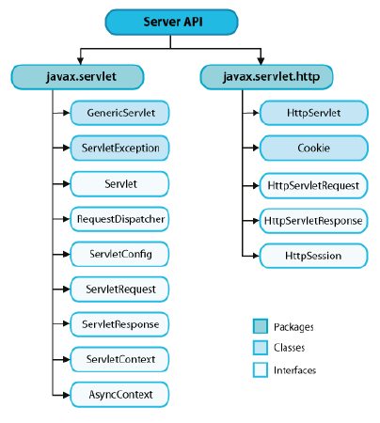
contd..
The following figure displays the class hierarchy of the Servlet API.

Slide 41
contd..
HttpServlet
Provides an abstract class to be subclassed to create an HTTP servlet suitable for a Web site. The subclass must override one of these methods:
doGet(), if the servlet supports HTTP GET requests
doPost(), for HTTP POST requests
doPut(), for HTTP PUT requests
doDelete(), for HTTP DELETE requests

Slide 42
contd..
Hierarchy of Servlet Classes –
javax
servlet.ServletRequest servlet.ServletResponse
servlet.http.HttpServletRequest servlet.http.HttpServletResponse

Slide 43
contd..
HttpServletRequest
Provides client request information to the servlet.
Provides access to
HTTP header data,
Cookie objects that the client sends with this request
current session associated with this request, or if the request does not have a session, creates one
the name or path of the servlet being called
query string
etc

Slide 44
contd..
HttpServletResponse
To assist a servlet in sending a response to the client provides access to
Add the specified cookie to the response
Set a response header with the given name and value.
Set the content type of the response being sent to the client
Return a PrintWriter object that can send character text to the client
Return a ServletOutputStream suitable for writing binary data in the response
etc

Slide 45
contd..
Types of HTTP requests - HTTP GET & HTTP POST
GET requests:
User entered information is appended to the URL in a query string
Can only send limited amount of data
../servlet/ViewCourse?FirstName=Sang&LastName=Shin
POST requests:
User entered information is sent as data (not appended to URL)
Can send any amount of data.
../servlet/ViewCourse.

Slide 46
contd..
GET vs. POST Request
GET | POST
Query string or form data is simply appended to the URL as name-value pairs. | Form name-value pairs are sent in the body of the request, not in the URL itself.
Query length is limited (~1KB). | Query length is unlimited.
Users can see data in address bar. | Data hidden from users.
doGet(). | doPost().
For getting (retrieving) data only. | For causing a change on the server (store data in DB).
ASCII. Easy to bookmark. Used more. | ASCII + Binary.Hard to bookmark. Used less.

Slide 47
contd..
Choosing HTTP GET or HTTP POST
Use GET if :
The interaction is more like a question (i.e., it is a safe operation such as a query, read operation, or lookup).
Use POST if :
The interaction is more like an order, or
The interaction changes the state of the resource in a way that the user would perceive (e.g., a subscription to a service).

Slide 48
contd..
HTTP-Specific Methods Purpose
getUserPrincipal() Gets user’s identity
doGet(HttpServletRequest req, HttpServletResponse res) Called by the server (via the service method) to allow a servlet to handle a GET request.
doPost(HttpServletRequest req, HttpServletResponse res) Called by the server (via the service method) to allow a servlet to handle a POST request.

Slide 49
Life Cycle of a Servlet
The lifecycle of a servlet is managed by the Web container. The interface javax.servlet.Servlet provides these methods –
init() – The init() method is called during the initialization phase of the servlet life cycle.
service() – When the client requests for the servlet, the Web container invokes the service() method of the servlet to process the client requests.
destroy() – The Web container calls the destroy() method when the servlet instance is not required to service any subsequent client request.

Slide 50
contd..
When a request is mapped to a servlet, the container performs the following steps.
If an instance of the servlet does not exist, the Web container
Loads the servlet class.
Creates an instance of the servlet class.
Initializes the servlet instance by calling the init method.
Invokes the service method, passing a request and response object.
If the container needs to remove the servlet, it finalizes the servlet by calling the servlet's destroy method.

Slide 51
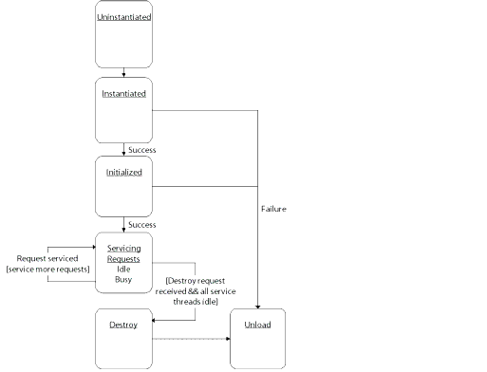
contd..

Slide 52
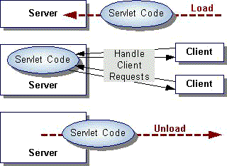
contd..

Slide 53
contd..
Initializing a Servlet
When a server loads a servlet for the first time, the server runs the servlet's init() method. This process is called as initialization.
The server calls the init() method once, i.e. when the server loads the servlet, and again when the servlet is reloaded.
init() and destroy(), to manage resources that are held for the life of the servlet
getServletInfo() a method which the servlet uses to provide information about itself

Slide 54
contd..
Servlet Configuration
To configure a servlet and other aspects of a web application, place a web.xml file in the WEB-INF directory.
<?xml version="1.0" encoding="UTF-8"?>
<web-app version="2.5" xmlns="http://java.sun.com/xml/ns/javaee"
xmlns:xsi="http://www.w3.org/2001/XMLSchema-instance"
xsi:schemaLocation="http://java.sun.com/xml/ns/javaee
http://java.sun.com/xml/ns/javaee/web-app_2_5.xsd” >
<servlet>
<servlet-name>SomeName</servlet-name>
<servlet-class>package.MyHttpServlet</servlet-class>
</servlet>
<servlet-mapping>
<servlet-name>SomeName</servlet-name>
<url-pattern>/myservlet</url-pattern>
</servlet-mapping>
</web-app>

Slide 55
contd..
Mappings
Server uses the following types of mappings when determining what file to serve up in response to a request:
Application mappings Associate the web application's URL with the physical directory that contains the application.
Servlet mappings Associate a servlet with a prefix (such as /servlet) or suffix (such as *.jsp).

Slide 56
Servlet Annotations
Annotations have been introduced since version 3.0
@WebServlet (“/urlpattern”) – A class level annotation. This annotation tells the container that the designated class is a Servlet class. It can be referred with the url pattern mentioned.

Slide 57
Processing of a Servlet Request
The following steps describe processing of a client request by a servlet:
A user sends a request to the server by using the Web browser. The server then forwards the request to the Web container.
The Web container in turn creates the HttpServletRequest and HttpServletResponse objects for request handling and response generation
The Web container identifies the requested servlet, and then initializes the identified servlet thread by calling the init() method.
The Web container calls the service() method of the servlet to enable the servlet to process the client requests.
Depending upon the type of request, the service() method invokes the doGet() or doPost() method.
The doGet() method generates a response for the client and attaches it with the response object.

Slide 58
contd..
Interfacing with HTML Requests
The container handles things like parsing the request and placing the information into a Request object; there are situations wherein these are manually coded.
The sequence is-
Retrieve HTML form parameters from the request
Retrieve a servlet initialization parameter
Retrieve HTTP request header information
Set an HTTP response header; set the content type of the response
Acquire a text stream for the response
Acquire a binary stream for the response
Redirect an HTTP request to another URL

Slide 59
contd..
Form Parameters
Parameters are sent in the query string or posted form data. The interface that defines the form parameter methods is ServletRequest.
getParameter(String) – It returns the value of a request parameter as a string, or null if the parameter does not exist.
getParameterValues() – If used with a multivalued parameter, no error generated. It returns the first value in the array returned.
getParameterMap() – used to create a map of the form parameters supplied with this request.
getParameterNames() – returns an Enumeration of string objects containing the names of the parameters contained in this request, or an empty Enumeration if the request has no parameters.
getParameterValues(String) – returns an array of values as strings, or null if the parameter does not exist. If the parameter has a single value, the array has a length of 1.

Slide 60
Servlet–Execution model
The servlet execution follows the thread model of execution.
1. Each of the HTTP methods –
GET, POST, PUT and DELETE are how browsers and Web servers communicate.
The HttpServlet class has a corresponding method for each HTTP method, viz.. doGet(), doPost(), doPut() and doDelete().
2. To each of the HTTP methods, GET, POST, and HEAD,
identify triggers that will cause a browser to use the method.
3. Identify the interface and method to access values and resources and to set object attributes within the following three Web scopes:
Request
Session
Context

Slide 61
contd..
4.
To get the values from HTML controls like text areas etc, request parameters are used.
To initialize the servlets and/or servlet context, initial parameters are used.
To pass data around in the request, session or servlet context objects, attributes are used.
Attributes can also appear in the request (and a couple of other scopes as well).
Once a servlet gets a request, it can add additional attributes, then forward the request off to another servlet for processing.
Attributes allow servlets to communicate with one another.

Slide 62
contd..
Servlet Working –
The servlet program and compiled class file are placed it in the appropriate folders.
When the Servlet Container starts, it preloads the servlet in memory if specified in the web.xml configuration file. If the servlet is not loaded (not listed in the web.xml configuration file), its instance will be created as soon as a request for it is received by the Servlet Container.
The first time it is loaded, the container calls the servlet's init() method, if there is one.
The container then will call the service() method each time a request is received ;

Slide 63
contd..
The doXXX() methods are the ones that are overriden.
The service() method then passes the request on to the appropriate method (usually GET for simple requests and POST to submit data, say a Web page form) such as the doGet() method if it is a GET request, or the doPost() method if it is a POST request.
The servlet processes the request (code written in doGet()), returning a response to the container.
The container then sends the text of the response back to the browser.

Slide 64
contd..
Filtering request types - The service method that calls the doXXX() methods. A typical code for service() method is –
Note: Its possible to preprocess the request before sending it on to the appropriate doXXX() method.

Slide 65
contd..
The destroy() method is called one time, upon the removal of the servlet from memory due either to explicit removal or lack of use (for example, the session expires).
The destroy() method, like init(), is called only once. It is called when the servlet is taken out of service and all pending requests to a given servlet are completed or have timed-out.
A call to destroy() releases resources such as database connections and threads. Its possible to call super.destroy()
destroy() is not called if the container crashes.

Slide 66
Servlet Context
Context means application scope. Contexts allow multiple servlets to exchange data and access each other’s fields.
The Context object maintains information (context) about the Web application.
The methods getInitParameter () and getInitParameterNames() retrieve context-wide, application-wide, or "Web application" parameters.
getInitParameter () – returns string containing the value of the parameter, or null if the parameter does not exist.
if parameters have no information, it returns a string containing the Servlet Container name and version number,
getInitParameterNames() – retrieves the names of the servlet's initialization parameters as an Enumeration of string objects. If there aren't any, it returns an empty Enumeration.
Note – The Java Virtual Machine creates a memory box for all of those, called as ServletContext object.

Slide 67
contd..

Slide 68
Servlet Config
An object of ServletConfig – created by the web container for each servlet.
ServletConfig object is created by web container for each servlet to pass information to a servlet during initialization. This object can be used to get configuration information from web.xml file.
When to use : if any specific content is to be modified from time to time.
Methods of ServletConfig interface
public String getInitParameter(String name) : Returns the parameter value for the specified parameter name.
public Enumeration getInitParameterNames() : Returns an enumeration of all the initialization parameter names.
public String getServletName() : Returns the name of the servlet.
public ServletContext getServletContext() : Returns an object of ServletContext.

Slide 69
contd..

Slide 70
Servlet Navigation
RequestDispatcher –
defines an object that receives requests from the client and sends them to any resource (such as a servlet, HTML file, or JSP file) on the server.
The servlet container creates the RequestDispatcher object, which is used as a wrapper around a server resource located at a particular path or given by a particular name.
An object implementing the RequestDispatcher interface may be obtained via the following methods:
ServletContext.getRequestDispatcher(String path)
ServletContext.getNamedDispatcher(String name)
ServletRequest.getRequestDispatcher(String path)

Slide 71
Flow Diagram
Forward Request
Include Request
Servlet - 1
Servlet - 1
Terminate
Forward Request
Include Request
Terminate
Servlet - 2
Servlet - 2

Slide 72
contd..
The ServletContext.getRequestDispatcher() method takes a String argument describing a path within the scope of the ServletContext. This path must be relative to the root of the ServletContext and begin with a '/'.
The ServletContext.getNamedDispatcher() method takes a String argument indicating the NAME of a servlet known to the ServletContext.
The ServletRequest.getRequestDispatcher() method provided in the ServletRequest interface, is for the RequestDispatcher objects to be obtained using relative paths that are relative to the path of the current request (not relative to the root of the ServletContext).
getAttribute() and setAttribute() Gets and sets attributes, which are used for passing data between components

Slide 73
sendRedirect()
sendRedirect() method redirects the response to another resource. This method actually makes the client(browser) to create a new request to get to the resource. The client can see the new url in the browser.
sendRedirect() accepts relative URL, so it can go for resources inside or outside the server.
redirection makes the client(browser) create a new request to get to the resource, the user can see the new URL while request dispatch get the resource in same request and URL does not change.
sendRedirect() works on response object while request dispatch work on request object.

Slide 74
Java Server Pages

Slide 75
Concepts
JSP technology is used in the development of Web interfaces for enterprise applications.
A JSP page is a text-based document, describes how to process a request and construct a response.
JSPs are server resident Java classes, like servlets, and executed in J2EE Server environment.
segregates content generation from content presentation.
an expression language for accessing server-side objects.
provides mechanisms for defining extensions to the JSP language.
A .jsp file is always compiled to servlets when they are
loaded for the first time, and subsequent modifications.

Slide 76
contd..
JSP makes layer separation possible by reusable component technologies like the JavaBean component architecture.
JSP pages can be moved without any changes across platforms and web servers working on “Write Once, Run Anywhere" paradigm.
JSP can service a diverse clientele
conventional browsers using HTML/DHTML
handheld wireless devices like mobile phones and PDAs using WML
B2B applications using XML.

Slide 77
contd..
General Structure of JSP program
<%@ page language = “java” %>
<html>
<body>
<%! int count = 0 ; %>
<% count++ ; %>
Welcome you are visitor no:
<%= count %>
</body>
</html>
In JSP page –
HTML part takes care of formatting and presentation.
Java portions are responsible for generating dynamic
content.

Slide 78
contd..
JSP is a tag-based language.
The tags help the container to interpret the enclosed script suitably.
JSP tags fall into the following categories:
Directives
Scripting Elements
Expressions
Standard Actions
Custom Tags
JSP tags are case sensitive.

Slide 79
contd..
Directives :
affect the overall structure of the servlet that results from the translation of JSP.
these are used to set global values for the JSP file as a whole.
page :
defines the attributes like import, session, so on, which are common to the entire JSP page.
<%@page import= ”java.rmi.*, java.util.*” session=”true”%>

Slide 80
contd..
include :
it directs the container to include the specified JSP, HTML, or other file types, in the current file.
the specified resource is copied inline, and it happens during translation time.
any subsequent changes to the included resource will not be reflected in the JSP, unless recompiled.
<%@ include file=”/hello.html” %>
taglib :
allow the page to declare and define custom tags.

Slide 81
contd..
2. Scripting Elements
scripting elements provide for inserting java code into the jsp page.
scripting elements are of three types.
Declarations :
declarations enclose Java code that defines class-wide
variables and methods.
declarations are initialized when the JSP page is initialized.
they are automatically made available to other
declarations, expressions, and code within that page.
enclosed within the tag sets <%! javacode %>

Slide 82
contd..
Scriptlets :
scriptlet is a block of Java code executed during run time (request processing time).
scriptlets provide for writing fully functional Java code.
multiple scriptlets in the same JSP page are combined together in the same order when the container generates the servlet.
enclosed within tag sets <% java statements %>
3. Expressions :
an expression is a scriptlet that is evaluated by the JSP
container and “sent to the client” for being displayed.
enclosed within tag sets <%= “the value of x =“ x %>

Slide 83
contd..
4. Standard Actions
actions are the tags that define the behavior of the JSP
during run time.
provide for dynamic insertion and reuse of components
jsp:include –
provides for inserting the files into the page being
generated.
the syntax is <jsp:include page = “relative URL”/>
jsp:forward –
provides forward the request to another page.
the URL attribute can be static or can be got at request time.
the syntax is <jsp:forward page =“relative URL”/>

Slide 84
contd..
jsp:useBean –
provides to load a Java bean to be used in JSP page.
the method to instantiate an object of the class and bind it to a variable with the name specified by id.
the syntax is <jsp:useBean id =“name” class = “pkg.cls”/>
jsp:getProperty –
the action converts property names following bean standards
the jsp:getProperty action retrieves the value of each bean property and converts it to a string and inserts it into the output.
the two attributes are name, and property.
the syntax is <jsp:getProperty name=“itembean”>

Slide 85
contd..
jsp:setProperty
The syntax is <jsp:setProperty name = “beaninst”
| property=“propertyname” | value = “string” | expression />
jsp:plugin
The syntax is <jsp:plugin type = “ ” class=“ ” codeBase = “ “ value = “string” />

Slide 86
contd..
Content type is included in the page directive.
<%@ page contentType="text/html.wap.wml"%>
Static Content –
the fixed (hard coded) contents of a JSP page are referred as static content.
static content can be expressed in any text-based format, such as HTML, WML, and XML.
2. Dynamic Content –
the content generated by the JSP page during execution phase are referred as dynamic content.
dynamic content are generated by the use of various JSP tags.

Slide 87
contd..
Java Bean –
Java Beans are reusable components that can be integrated to create software applications.
Components written in other languages can be integrated with Java components using a special interface.
Simple components can be assembled to produce complex component.
Bean –
can be visual or non-visual.
Bean class – Any user-defined class can be a bean class.
However the class must define the following –
must have a zero-argument constructor
must provide accessor methods to properties

Slide 88
contd..
A simple Bean class –
public class Employee
{
private int empid;
private String ename;
public int getEmpid()
{ return empid ; }
public void setEmpid(int i)
{ empid = r; }
public String getEname()
{ return ename ; }
public void setEname(String s)
{ ename = s; }
}

Slide 89
Object Scopes
Scope or Visibility of Java objects within
JSP pages –
Objects may be created implicitly using JSP directives, explicitly through actions, or, in rare cases, directly using scripting code.
The instantiated objects can be associated with a scope attribute defining where there is a reference to the object and when that reference is removed.

Slide 90
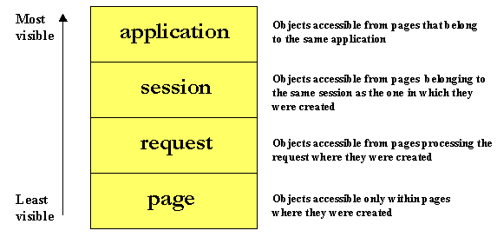
contd..
The following diagram indicates the various scopes that can be associated with a newly created object:

Slide 91
contd..
JSP Implicit Objects
The JSP container makes available implicit objects that can be used within scriplets and expressions, without the page author first having to create them.
These objects act as wrappers around underlying Java classes or interfaces typically defined within the Servlet API.
The nine implicit objects –
1. request: represents the HttpServletRequest triggering the service invocation. Request scope.
2. response: represents HttpServlet Response to the request. Not used often by page authors. Page scope.
3. pageContext: encapsulates implementation-dependent features in PageContext. Page scope.

Slide 92
contd..
4. application: represents the ServletContext obtained from servlet configuration object. Application scope.
5. out: a JspWriter object that writes into the output stream. Page scope.
6. config: represents the ServletConfig for the JSP. Page scope.
7. page: synonym for the "this" operator, as an HTTPJspPage. Not used often by page authors. Page scope.
8. session: An HttpSession. Session scope.
9. exception: The uncaught Throwable object that resulted in the error page being invoked. Page scope.
Note – These implicit objects are only visible within the system generated _jspService() method and not in user-defined methods.

Slide 93
contd..
JSP or Servlets ?
Use servlets strictly as a web server extension technology. E.g. implementation of specialized controller components offering services like authentication, database validation, and so forth.
The "JSP engine“ is a specialized servlet running under the control of the servlet engine.
JSP deals only with textual data, hence servlets are needed when communicating with Java applets and applications.
Use JSP to develop typical web applications that rely upon dynamic content.
JSP should also be used in place of proprietary web server extensions like server-side includes as it offers excellent features for handling repetitive content.

Slide 94
JSP Execution Model
JSP pages are subjected to a translation phase and a request processing phase.
The translation phase is carried out only once, unless the JSP page changes, in which case it is repeated.
The result is a JSP page implementation class file that implements the Servlet interface, as shown below.
The translation phase is typically carried out by the JSP engine itself, when it receives an incoming request for the JSP page for the first time.
Many details of the translation phase, like the location where the source and class files are stored are implementation dependent.

Slide 95
contd..
On JSP Page Request –
the request is mapped to a JSP page;
the Web container first checks whether the JSP page's servlet is older than the JSP request page;
if yes, then the Web container translates the JSP page into a servlet class and compiles the class;
The lifecycle of a JSP page contains the following phases –
Translation and compilation phase
Execution phase

Slide 96
contd..
The JSP page implementation class file extends HttpJspBase, which in turn implements the Servlet interface.
The service method of this class, _jspService(), inlines the contents of the JSP page.
The _jspService() cannot be overridden, the developer can describe initialization and destroy events by providing implementations for the jspInit() and jspDestroy() methods within their JSP pages.
Once this class file is loaded within the servlet container, the _jspService() method is responsible for replying to a client's request.

Slide 97
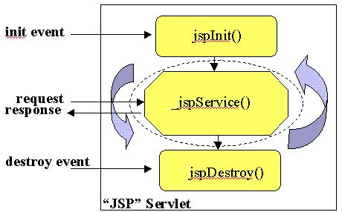
contd..
By default, the _jspService() method is dispatched on a separate thread by the servlet container in processing concurrent client requests.

Slide 98
contd..
JSP Access Models
The early JSP specifications advocated two philosophical approaches, popularly known as Model 1 and Model 2 architectures, for applying JSP technology.
The approaches differ essentially in the location at which the bulk of the request processing was performed, and offer a useful paradigm for building applications using JSP technology.

Slide 99
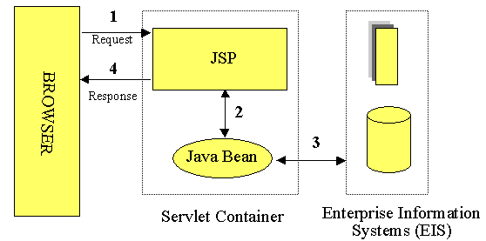
Model 1

Slide 100
contd..
Model 1 architecture –
The incoming request from a web browser is sent directly to the JSP page, which processes it and responses back to the client.
All data access is performed using beans, hence provides for separation of presentation from content.
Suitable for simple applications, but not desirable for complex implementations.
Will lead to large amount of scriptlets or Java code embedded within the JSP page. (in case of significant amount of request processing).
The JSP pages must be individually responsible for managing application state and verifying authentication and security.

Slide 101
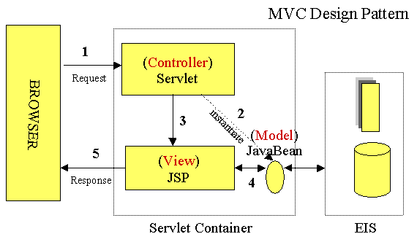
Model 2

Slide 102
contd..
Model 2 architecture –
The Model 2 architecture is a server-side implementation of the popular Model-View-Controller design pattern.
The processing is divided between front and presentation components.
Front components known as controllers process all the HTTP requests. Usually a servlet or JSP.
Provide for creating any beans or objects used by the presentation components,
Depending on the user's actions, decide which presentation component to be forwarded.
Presentation components known as view are JSP pages that generate the HTML/XML response.

Slide 103
contd..
The front components present a single point of entry into the application, thus making the management of application-state, security, and presentation uniform and easier to maintain.
There is no processing logic within the presentation component itself;
The clean separation of presentation from content leads to a clear delineation of the roles and responsibilities of the developers and page designers on the programming team.

Slide 104
Expression Language
EL – a mechanism for enabling the presentation layer (web pages) to communicate with the application logic (managed beans).
is used by JavaServerFaces technology and JavaServer Pages(JSP) technology
EL provides a way to use simple expressions to perform the following tasks:
Dynamically read application data stored in JavaBeans components, various data structures, and implicit objects
Dynamically write data, such as user input into forms, to JavaBeans components
Invoke arbitrary static and public methods
Dynamically perform arithmetic operations

Slide 105
contd..
JSF uses EL mainly because
Deferred and immediate evaluation of expressions
The ability to set as well as get data
The ability to invoke methods
The EL defines the following literals -
Boolean: true and false
Integer: as in Java
Floating-point: as in Java
String: with single and double quotes; " is escaped as \", ' is escaped as \', and \ is escaped as \\
Null: null

Slide 106
contd..
EL provides the following operators, which can be used in rvalue expressions only:
Arithmetic: +, - (binary), *, / and div, % and mod, - (unary)
Logical: and, &&, or, ||, not, !
Relational: ==, eq, !=, ne, <, lt, >, gt, <=, ge, >=, le. Comparisons can be made against other values or against Boolean, string, integer, or floating-point literals.
Empty: The empty operator is a prefix operation that can be used to determine whether a value is null or empty.
Conditional: A ? B : C. Evaluate B or C, depending on the result of the evaluation of A.

Slide 107
contd..
The precedence of operators highest to lowest, left to right is as follows:
[] .
() (used to change the precedence of operators)
- (unary) not ! empty
* / div % mod
+ - (binary)
< > <= >= lt gt le ge
== != eq ne
&& and
|| or
? :

Slide 108
contd..
A literal expression is evaluated to the text of the expression, which is of type String.
Note : A literal expression does not use the ${} or #{} delimiters.
the reserved characters ${} or #{}, need to be escape
By creating a composite expression as shown here:
${'${'}exprA}#{'#{'}exprB}
The resulting values would then be the strings ${exprA} and #{exprB}.
By using the escape characters \$ and \# to escape what would otherwise be treated as an eval-expression:
\${exprA}\#{exprB}
The resulting values would again be the
strings ${exprA} and #{exprB}.
When a literal expression is evaluated, it can be converted to another type.

Slide 109
Thank You

